Slide 1
UNIT 2 Bayes Theorem, Central Limit Theorem
Presented By :
Aditya Joshi
Assistant Professor
Graphic Era Deemed to be University, Dehradun

Slide 2






















Conditional Probability
In conditional probability we have to find out the probability of something given, that we have some other piece of information.

Slide 3




























Slide 4












The % of adults who are men and alcoholics is 2.25%. And prob of being a man is 50% What is the probability of being an alcoholic , given being a man ?

Slide 5

P(A|B)=$\frac{\text{P}\text{(}A∩B)}{P(B)}$
P(B|A)=$\frac{P(B∩A)}{P(A)}$
P(A|B)=$\frac{\text{P}\text{(}\text{B}\text{|}\text{A}\text{).}\text{P}\text{(}\text{A}\text{)}}{P(B)}$

Slide 6








There are two children of a parent.What is the probability of two girls given at least one girl?
P(2 Girls|at least 1 girl)=$\frac{\text{P}\text{(1 }\text{Girl}\text{|2 }\text{G}\text{irls}\text{)}\text{∗}\text{P}\text{(2 }\text{Girl}\text{)}}{P(1 Girl)}$

Slide 7
Bayesian Modeling
Bayesian Model is a probabilistic model(a system of making inference) that is based on bayes theorem. The Bayesian Model attempts to obtain a posterior distribution. Given by Thomas Bayes.
For example, if we have the density function for some observations X_{i}
For i=1 to n to be f(X_{i}| θ) for unknown parameter θ
Then the Prior distribution is given by p(θ), Bayesian Model would try to find out the parameter using the posterior p(θ |X)
A function that relates one variable to another

Slide 8

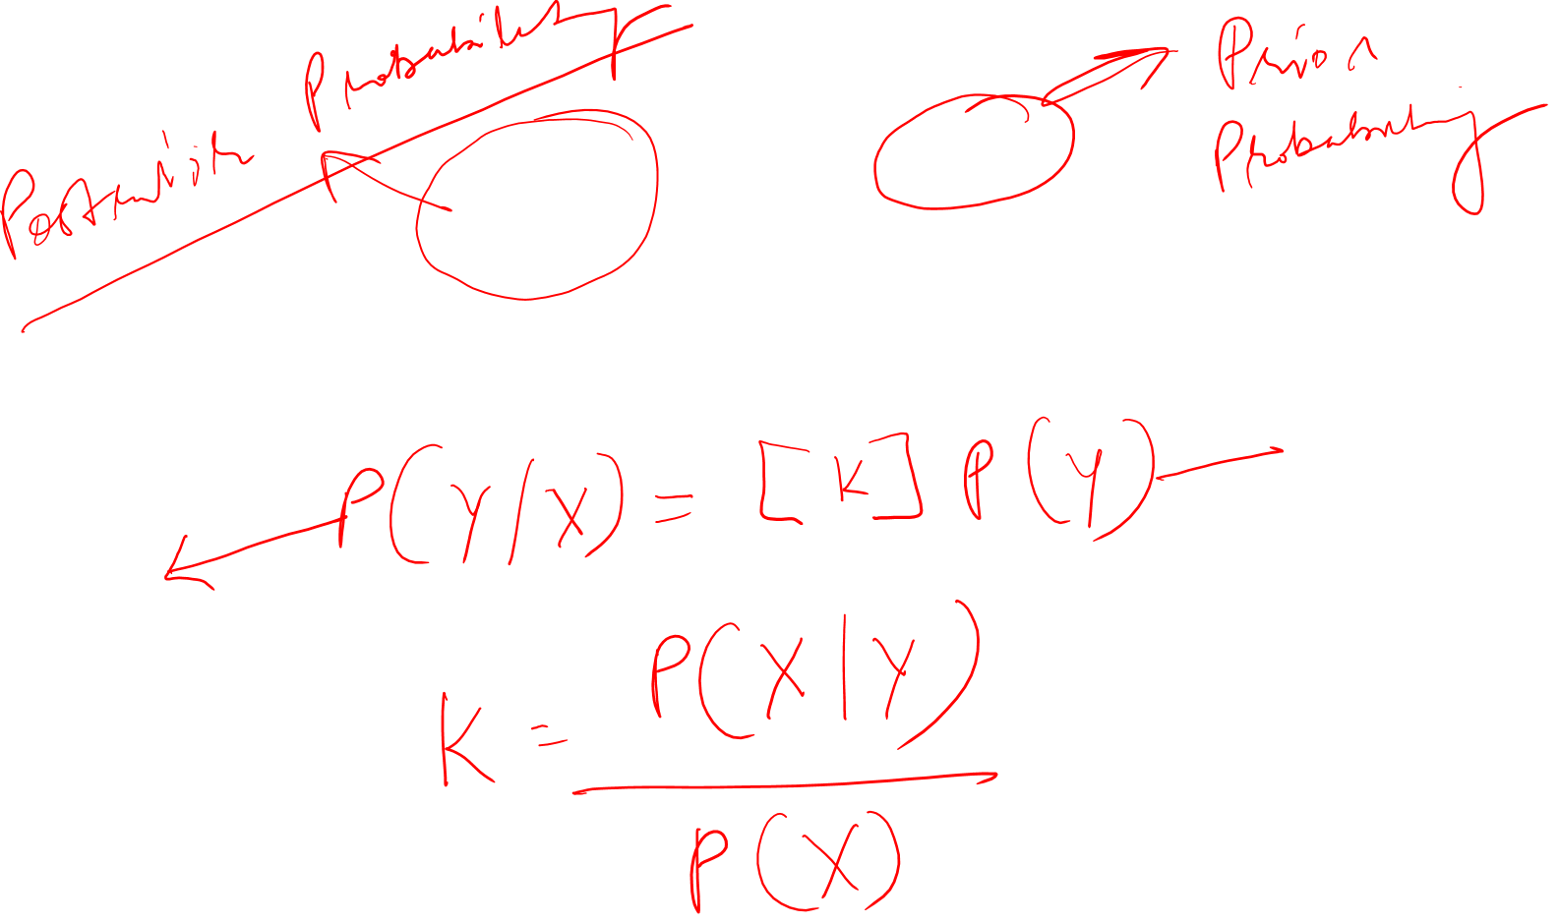
Bayes Theorem is
$$P\left(Y | X\right)=\frac{P\left(X | Y\right)P(Y)}{P(X)}$$

Slide 9
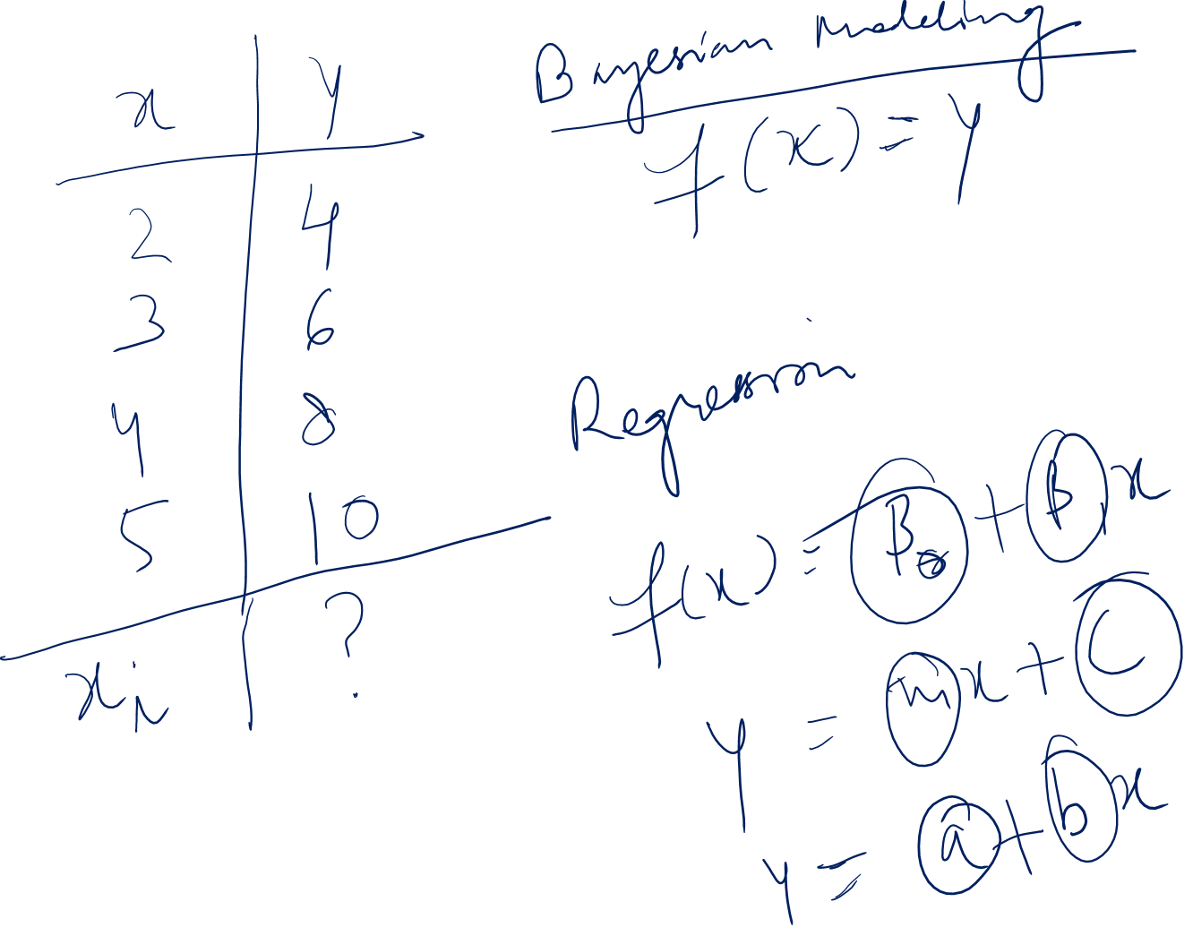

Slide 10
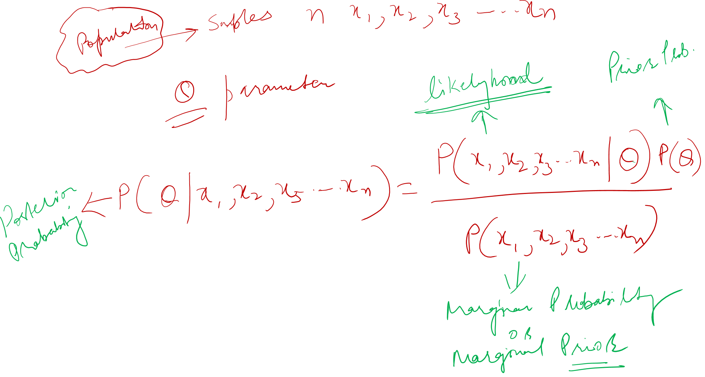

Slide 11
Central Limit Theorem
The Central Limit Theorem states that the sampling distribution of the sample means approaches a normal distribution as the sample size gets larger — no matter what the shape of the population distribution. This fact holds especially true for sample sizes over 30.
All this is saying is that as you take more samples, especially large ones, your graph of the sample means will look more like a normal distribution.
Here’s what the Central Limit Theorem is saying, graphically. The picture below shows one of the simplest types of test: rolling a fair die. The more times you roll the die, the more likely the shape of the distribution of the means tends to look like a normal distribution graph.

Slide 12
A Central Limit Theorem word problem will most likely contain the phrase “assume the variable is normally distributed”, or one like it. With these central limit theorem examples, you will be given:
A population (i.e. 29-year-old males, seniors between 72 and 76, all registered vehicles, all cat owners)
An average (i.e. 125 pounds, 24 hours, 15 years, $15.74)
A standard deviation (i.e. 14.4lbs, 3 hours, 120 months, $196.42)
A sample size (i.e. 15 males, 10 seniors, 79 cars, 100 households)
You will get one of three central limit theorem examples:
I want to find the probability that the mean is greater than a certain number
I want to find the probability that the mean is less than a certain number
I want to find the probability that the mean is between a certain set of numbers either side of the mean

